Slide 1

iPhone Camera Application Usability Analysis
Performed By:
Jason Bowman
Benjamin VanLuven
Ciara Rodriguez
Daniel Ablanedo

Slide 2
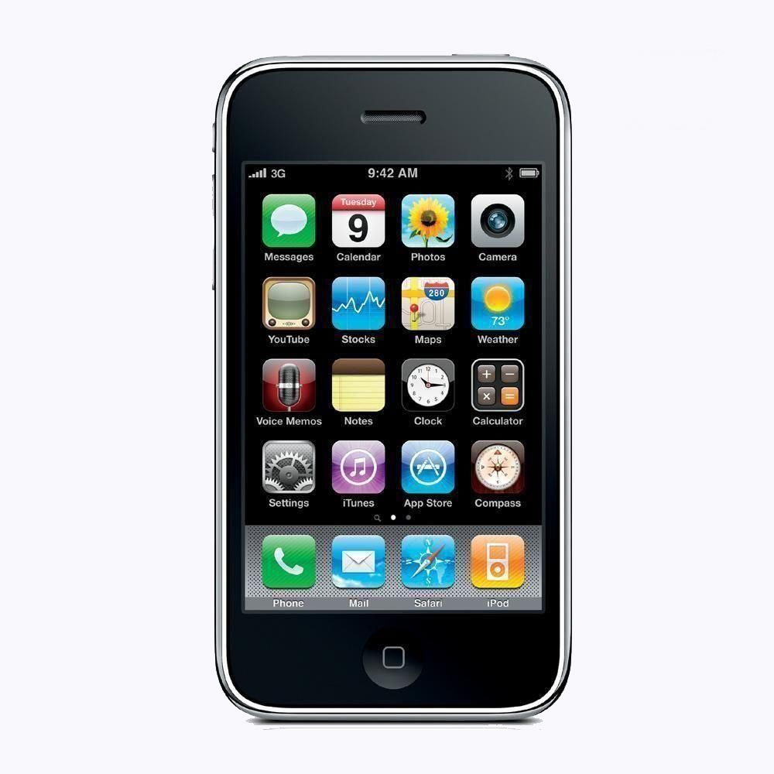
Introduction
A poll by PC Magazine determined that 43% of users use
a cellphone camera exclusively. Why?
High quality of modern smartphone cameras
Convenience of only having to carry one device
Ability to post photos to the internet seamlessly

Slide 3
Introduction
This experiment is an examination of the camera
interface that comes standard with any iPhone.

Slide 4
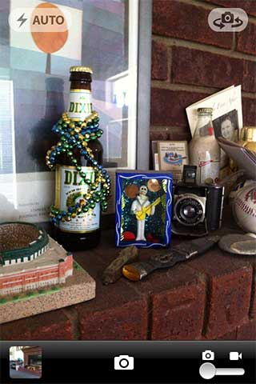
Interface Description
The iPhone camera application is a touch screen interface that offers many of the same functions as a typical point and shoot camera.
Flash Control
Lens Selector
Photo Library
Shutter Release/ Record Button
Camera Type Selector
Options Menu (not pictured)

Slide 5
Communication With User
The iPhone uses a variety of both visual and audio cues and state changes to help the user manipulate the interface.
These include:
A clicking sound (similar to the sound of a 35mm SLR camera) to indicate that a picture has been taken.
A beep to let the user know when the video camera is turned on or off
A closed shutter to indicate mode change or to indicate that a still photo was taken.
A photo icon that shrinks and moves to become the library icon, indicating that the picture or video was stored

Slide 6
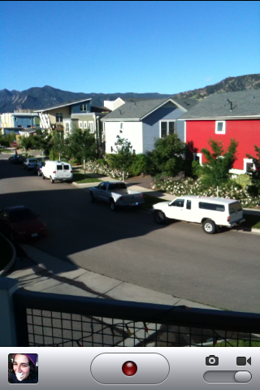
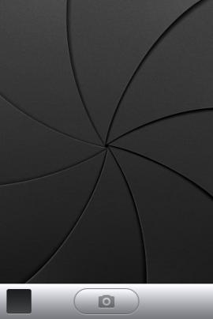
Visual Cues

Slide 7
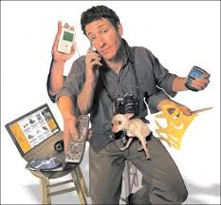
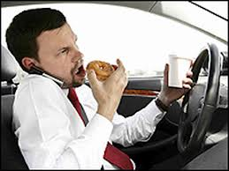
Important Design Considerations
Mobile devices have some unique usability issues:
Distracted or multitasking users
Control placement and priority
Button size and spacing
Error rate/recovery

Slide 8
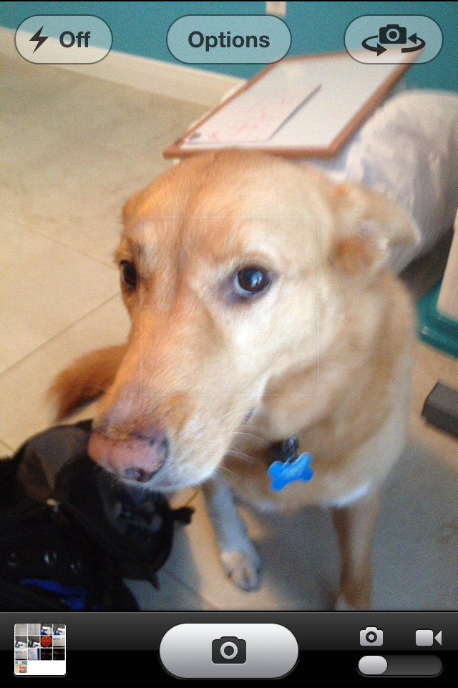
Usability Analysis
The iPhone camera utilizes several good design strategies:
So as to be less distracting to the user, the less frequently used controls are smaller and semi transparent.
Shutter release/Record button is larger and more pronounced. It is also located so a one handed user can activate it with a thumb.

Slide 9
Usability Analysis
Inconsistencies of design sometimes fooled users:
Although the appearance of the camera type selector suggests that it is a slide bar, many users tried to continually tap it, because all other controls were tap activated.
Unlike the other controls, the photo library is not an icon, it is a miniature version of the last picture taken. It can be difficult to locate if the last picture taken was very dark.

Slide 10
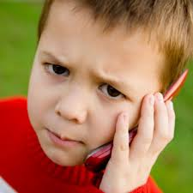
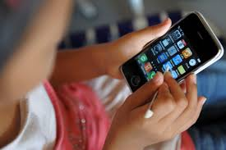
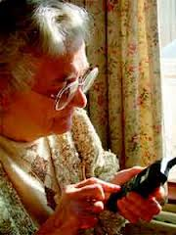
Related Research
Although there has been extensive research on mobile device usability, the vast majority of the research focuses on the characteristics of the interface, and the tasks performed and not the user characteristics.

Slide 11

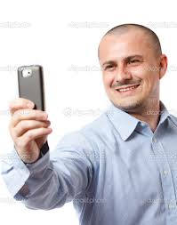
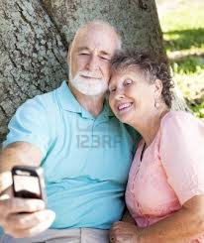
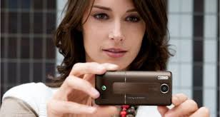
Goals of This Research
The purpose of this project is to select a diverse group of users and to determine what, if any user characteristics show either a positive or negative correlation with their ability to manipulate the iPhone camera interface.

Slide 12
The Experiment
Determine the basic functionality of the iPhone camera app
Select a varied population to test hypotheses
  Age groups
  Experience with smartphone technology
  Education level
  iPhone, smartphone, and feature phone users

Slide 13
The Experiment cont.
Posttest questions to gauge participants opinions of the iPhone camera app
  Ease of app use
  Would participants recommend the iPhone camera
  Comfort level with the camera app
  Suggestions for improvement
  Button sizes compared to functionality

Slide 14
Results – The Approach
Sort the pre and post-test survey results
Analyze statistically and visually
Look for trends
Compare to our hypotheses

Slide 15
Results – Processing Data
Data was relatively easy to process due to the small sample size.
Data entered into spreadsheet and textual answers such as agree/disagree converted into numerical values.
strongly disagree disagree neither disagree nor agree agree strongly agree
1 2 3 4 5

Slide 16
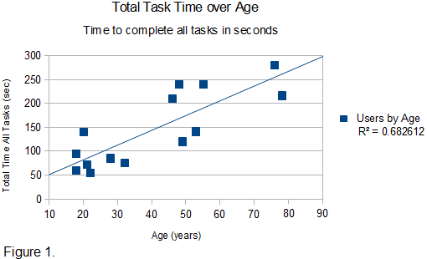
Results - Analysis
One hypotheses was that older smartphone users find phone interfaces hard to use than younger users, even with equal experience.

Slide 17
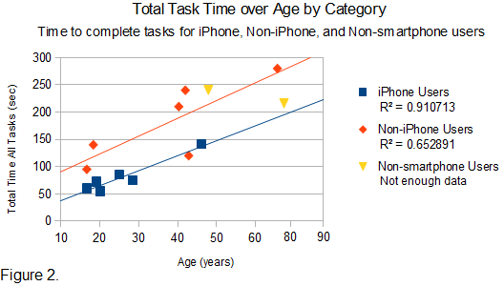
Results - Analysis
Small sample size makes it hard to be sure of correlations.
Some users do not fit trends, unmeasured factors may be affecting the analysis.

Slide 18
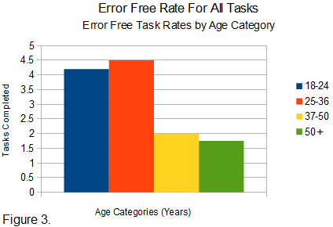
Results - Tends
Figure 1 and 2 showed a weak relationship between age and time to complete tasks.
There is a strong correlation between age and number of tasks completed successfully.

Slide 19
Results - Tends
Users' ratings of their own comfort with technology did not reflect their ability to complete tasks (linear 0.06).
Number of tasks completed did not even correlate to phone usage (linear 0.14).

Slide 20
Results - Hypotheses
Smartphone users could be categorized by their phone usage and/or comfort with technology.
False – non of the survey questions answered by users correlated to test results. Some other driving factor must be at work.

Slide 21
Results - Hypotheses
Smartphone users could be categorized by their phone usage and/or comfort with technology.
False – non of the survey questions answered by users correlated to test results. Some other driving factor must be at work.

Slide 22
Conclusion
This research has revealed several interesting trends
The data shows that a user’s comfort with technology has no relationship with their ability to manipulate the iPhone interface
  This was demonstrated with both the time on task and percentage of completed tasks metrics
Age was a main factor in the experiment results
  users younger than 35 were able to complete 87% of the tasks while those over 35 were able to complete only 37.6% of the tasks

Slide 23
Conclusion cont.
Older users demonstrated a much higher error rate
Interfaces need to be easy to use even for those people who are uncomfortable with technology
This research suggests that Apple could do a better
job designing their camera app interface to suit the needs of older users
Group goal accomplished

Slide 24

Questions?

